Slide 1
Relational and ER Models

Slide 2
Relational Model
What is Relational Model?

Slide 3
Objectives
Relational Model:
Structures, basics.
Attributes, simple composite,single valued and multivalued attributes.
Domains,Atomicity,Tuples.
Instance and Schema.
Keys,Superkey,Candidate key,Primary key, Foreign key, Unique key.
ER Model:
Entity,Relationship and Entity sets.
Mapping Cardinalities.
ER Diagram,Notation Guide.
Specimen ER Diagram.
Cardinality in ER Diagram.
Weak Entity sets.
Generalization and Specialization

Slide 4
What is Relational Model?
The relational model is today the primary data model for commercial data-processing applications. It has attained its primary position because of its simplicity, which eases the job of the programmer, as compared to earlier data models such as the network model or the hierarchical model.
Is based on a collection of tables. Users of which can create ,insert and modify tables,
There are several languages for database programming.
  SQL, Oracle, etc.

Slide 5
Structure of a Relational Model
Consists of a collection of tables, each of which is assigned a unique name.These tables can be called relations.
A row in a table represents a relationship among a set of values.
Correspondence between the concept of table and the mathematical concept of relations.
The following is one such example of a relation
Uni.Roll | Stud.Name | Number.Obt | Year
08120000 | Shankar | 98 | 1st
08123455 | Bill | 76 | 2nd
08125678 | Masate | 78 | 2nd

Slide 6

A few Basic Terms in A Relational Model
Attributes:
serve as names for the columns of the relation. Usually, an attribute describes the meaning of entries in the column as shown below.
Uni.Roll | Stud.Name | Number.Obt | Year
08120000 | Shankar | 98 | 1st
08123455 | Bill | 76 | 2nd
08125678 | Masate | 78 | 2nd

Slide 7
Types of Attributes
Simple attributes: Attributes which are not divided into subparts. Such as, an attribute account balance that holds only the current balance.
Composite attributes: Attributes that are divided into subparts. Such as a attribute name that has subparts first name, and last name.
Single valued attributes: The attributes that are supposed to have one single value only.Such as an attribute uni.roll is supposed to have ony one university roll per student.
Multi valued attributes: An attribute that can have more than one values. such as,an attribute phone number, that can have more than one phone number.

Slide 8
A few Basic Terms in A Relational Model
Domains:
For each attribute,its domain is the set of permitted values. e.g;In the last relation,the domain of the attribute stud.name is all possible names of the students in the university. And not their height or weights etc.
Mathematicians define a relation to be a subset of a Cartesian product of a list of domains.so,
a table of n attributes must be a subset of
D1 × D2 × · · · × Dn−1 × Dn

Slide 9
A few Basic Terms in A Relational Model
Atomicity:An attribute is said to be atomic if its domain is an indivisible set of permissible values.say,the domain of the set of integers are atomic.But,sets of integers are not.
Tuple:The rows of a relation,has one component for each attribute of a relation. A tuple variable is a variable that stands for a tuple
Tuple
Uni.Roll | Stud.Name | Number.Obt | Year
08120000 | Shankar | 98 | 1st
08123455 | Bill | 76 | 2nd
08125678 | Masate | 78 | 2nd

Slide 10
Instance and Schema
Schema:Schema is the overall Design of the Database
. Schema of a relation consists of
  attribute definitions
    name
    type/domain
  integrity constraints
For example Student Schema=(uni.roll,number.obt,stud.name,year)

Slide 11


Instance and Schema
Instance:Instance is the information stored in the Database at a particular moment
The current values (relation instance) of a relation are specified by a table .An element t of r is a tuple, represented by a row in a table.Order of tuples is irrelevant (tuples may be stored in an arbitrary order)
Uni.Roll | Stud.Name | Number.Obt | Year
08120000 | Shankar | 98 | 1st
08123455 | Bill | 76 | 2nd
08125678 | Masate | 78 | 2nd

Slide 12
Keys
Let K ⊆ R
K is a superkey of R if values for K are sufficient to identify a unique tuple of each possible relation r(R)
  by “possible r ” we mean a relation r that could exist in the enterprise we are modeling.
  Example: {customer_name, customer_street} and
  {customer_name}
  are both superkeys of Customer, if no two customers can possibly have the same name
    In real life, an attribute such as customer_id would be used instead of customer_name to uniquely identify customers, but we omit it to keep our examples small, and instead assume customer names are unique.

Slide 13
Keys (Cont.)
K is a candidate key if K is minimal
Example: {customer_name} is a candidate key for Customer, since it is a superkey and no subset of it is a superkey.
Primary key: a candidate key chosen as the principal means of identifying tuples within a relation
  Should choose an attribute whose value never, or very rarely, changes.
  E.g. email address is unique, but may change

Slide 14
Keys (Cont.)
Foreign Key: A relation schema may have an attribute that corresponds to the primary key of another relation. The attribute is called a foreign key.
  E.g. customer_name and account_number attributes of depositor are foreign keys to customer and account respectively.
  Only values occurring in the primary key attribute of the referenced relation may occur in the foreign key attribute of the referencing relation.
  Unique Key: The Unique key concept uniquely identifies each record in a database table.
  Similar to the Primary key,it provides guarantee for uniqueness for a column or set of columns.
  There can be many Unique key constraints per table, but only one Primary key constraint per table.And also permits null values.

Slide 15

Schema Diagram

Slide 16
Entity Relationship Model
The entity-relationship (E-R) data model perceives the real world as consisting of basic objects, called entities, and relationships among these objects.
An entity is a “thing” or “object” in the real world that is distinguishable from all other objects. For example, each person in an enterprise is an entity
An entity set is a set of entities of the same type that share the same properties, or attributes.For example,Student result is an entity set that is a collection of student entities having the same set of attributes.

Slide 17
Mapping Cardinalities
Express the number of entities to which another entity can be associated via a relationship set.
For a binary relationship set R between entity sets A and B the following can be the mapping Cardinalities.
One to one. An entity in A is associated with at most one entity in B, and an
B is associated with at most one entity in A
One to many. An entity in A is associated with any number (zero or more) of
An entity in B, can be associated with at most one entity in A.
Many to one. An entity in A is associated with at most one entity in B. An
entity in B, can be associated with any number (zero or more) of entities in A.
Many to many. An entity in A is associated with any number (zero or more) of
entities in B, and an entity in B is associated with any number (zero or more)
of entities in A.

Slide 18
Entity-Relationship Diagram
E-R diagram can express the overall logical structure of a database graphically. E-R diagrams are simple and clear—qualities that may well account in large part for the widespread use of the E-R model. Such a diagram consists of the following major components.(in the next slide)

Slide 19
Entity-Relationship Diagram
Rectangles, which represent entity sets
Ellipses, which represent attributes
Diamonds, which represent relationship sets
Lines, which link attributes to entity sets and entity sets to relationship sets
Double ellipses, which represent multivalued attributes
Dashed ellipses, which denote derived attributes
Double lines, which indicate total participation of an entity in a relationship set
Double rectangles, which represent weak entity sets

Slide 20
Notation Guide
ENTITY TYPE
WEAK ENTITY TYPE
RELATIONSHIP TYPE
IDENTIFYING RELATIONSHIP TYPE

Slide 21
… Notation Guide
ATTRIBUTE
KEY ATTRIBUTE
MULTIVALUED ATTRIBUTE
DERIVED ATTRIBUTE
COMPOSITE ATTRIBUTE
_____
. . .

Slide 22
ER Diagram Basics
Entity
sname
Store
Locations
Relationship
manager
qty
Keeps
Attributes
pname
Product
price
descrip

Slide 23


Slide 25


Slide 26
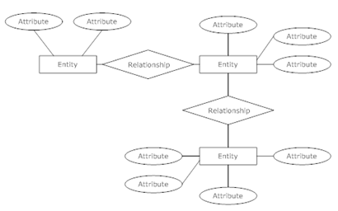
A Specimen ER Diagram

Slide 27
Cardinality In ER Diagram
A directed line from the relationship set borrower to the entity set loan specifies that borrower is either a one-to-one or many-to-one relationship set, from customer to loan.
An undirected line from the relationship set borrower to the entity set loan specifies that borrower is either a many-to-many or one-to-many relationship set from customer to loan.
A double line from any entity set to another denotes total participation,ie each record from the entity set is related to at least one entity set in the other

Slide 28
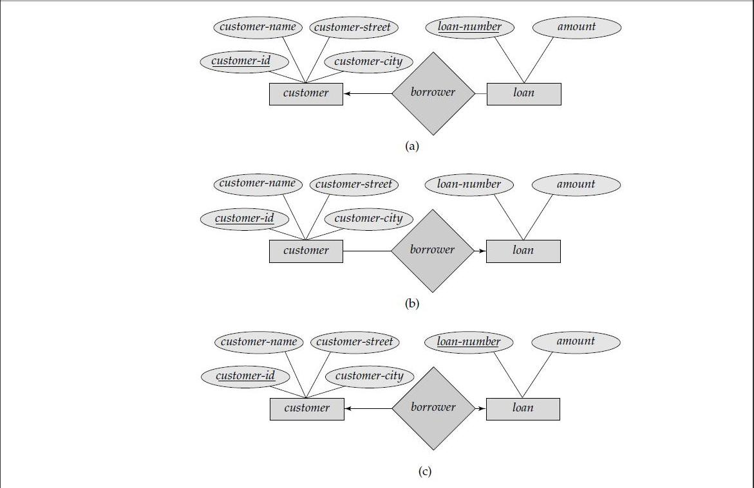
Cardinality In ER Diagram
a.One to many. b.many to one. c.one to one.

Slide 29
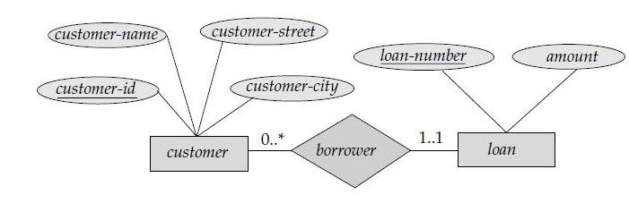
Cardinality in ER DIagram
The digit on the left of any line from a entity set to a relationship denotes the minimum,and,the right side denotes the maximum participation of that set in the relation.
For example,the 0…* in the line from customer to borrower indicates that a customer can have a minimum of zero and a max of unlimited number of loans.

Slide 30
Weak Entity sets
An entity set may not have sufficient attributes to form a primary key. Such an entity set is termed a weak entity set.
Weak entities can be mapped to the relational model by:
  Map each weak entity E that depends on a strong entity F to a new relation R
  Relation R contains all the attributes in E and the primary key of F
  The primary key for R is the primary key of E and the primary key of
For example,a set containing ‘issue number’,’issue date’ and ‘book name’ since there is no primary key in this set a primary key from another table say stud.id of the stud borrowing the book would serve as a part of its primary key,That is stud.id and issue no would serve as its primary key.

Slide 31
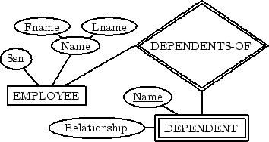
Weak Entity Sets
For example,a set containing ‘issue number’,’issue date’ and ‘book name’ since there is no primary key in this set a primary key from another table say stud.id of the stud borrowing the book would serve as a part of its primary key,That is stud.id and issue no would serve as its primary key.

Slide 32
Specialization
Top-down design process; we designate subgroupings within an entity set that are distinctive from other entities in the set.
These subgroupings become lower-level entity sets that have attributes or participate in relationships that do not apply to the higher-level entity set.
Depicted by a triangle component labeled ISA (E.g. customer “is a” person).
Attribute inheritance – a lower-level entity set inherits all the attributes and relationship participation of the higher-level entity set to which it is linked.

Slide 33

Specialization Example

Slide 34
Generalization
A bottom-up design process – combine a number of entity sets that share the same features into a higher-level entity set.
Specialization and generalization are simple inversions of each other; they are represented in an E-R diagram in the same way.
The terms specialization and generalization are used interchangeably.

Slide 35
Specialization and Generalization (Contd.)
Can have multiple specializations of an entity set based on different features.
E.g. permanent-employee vs. temporary-employee, in addition to officer vs. secretary vs. teller
Each particular employee would be
  a member of one of permanent-employee or temporary-employee,
  and also a member of one of officer, secretary, or teller
The ISA relationship also referred to as superclass - subclass relationship

Slide 36
Design Constraints on a Specialization/Generalization
Constraint on which entities can be members of a given lower-level entity set.
  condition-defined
    E.g. all customers over 65 years are members of senior-citizen entity set; senior-citizen ISA person.
  user-defined
Constraint on whether or not entities may belong to more than one lower-level entity set within a single generalization.
  Disjoint
    an entity can belong to only one lower-level entity set
    Noted in E-R diagram by writing disjoint next to the ISA triangle
  Overlapping
    an entity can belong to more than one lower-level entity set

Slide 37
Design Constraints on a Specialization/Generalization (Contd.)
Completeness constraint -- specifies whether or not an entity in the higher-level entity set must belong to at least one of the lower-level entity sets within a generalization.
  total : an entity must belong to one of the lower-level entity sets
  partial: an entity need not belong to one of the lower-level entity sets

